Slide 1

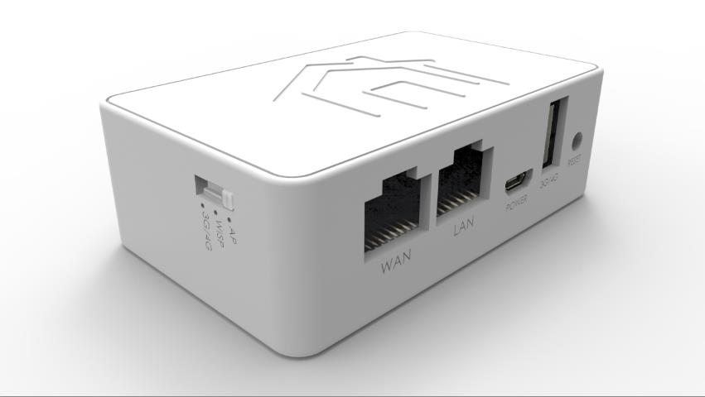
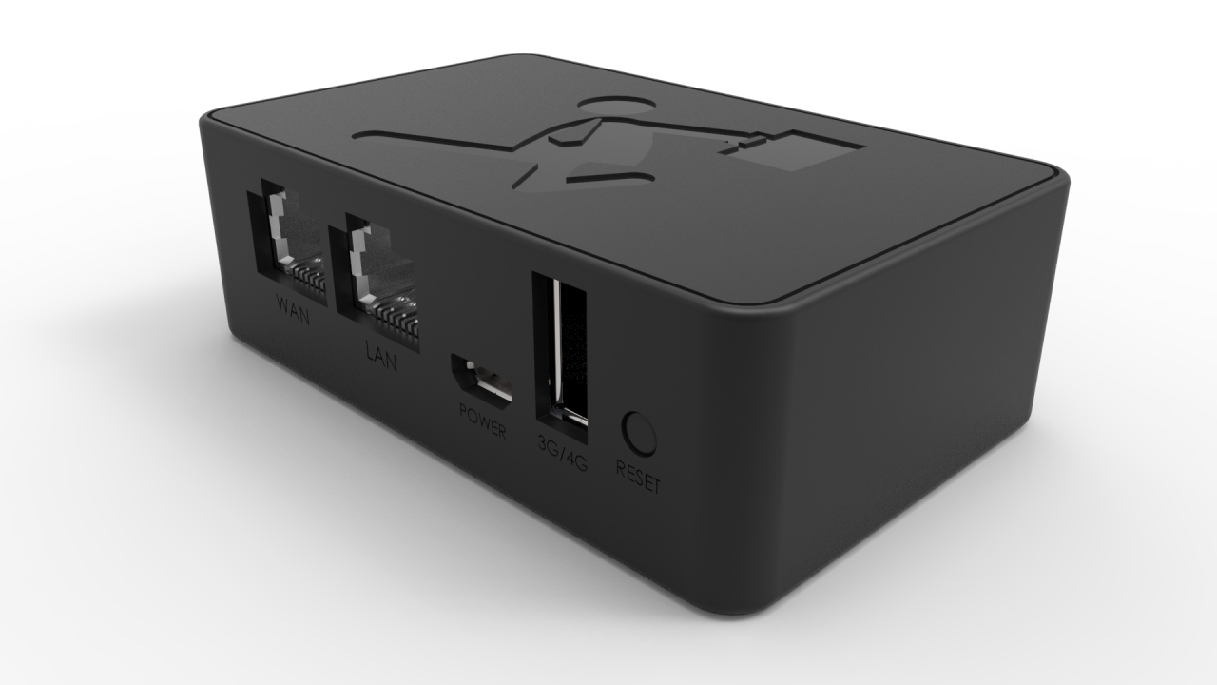
MiniVPN_White (WE101VWT)
MiniVPN_Black (BE101VWT)
Zebra’s Official Website：http://www.zebravpnbox.com/

Slide 2
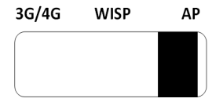
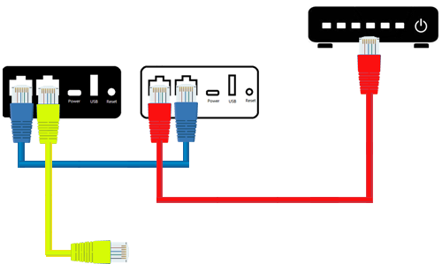


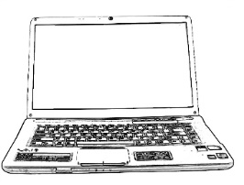
Set up VPN
❶ Connecting
the Devices
Chunghwa Telecom Router
(Public IP)
Black Box(MiniVPN_Black)
White Box (MiniVPN_White)
WAN
LAN
WAN
LAN
Mobile phone
or
PC
● Connect Black Box with White Box as following orders.
Then, connect White Box with the Telecom Router to access public IP.
Zebra’s Official Website：http://www.zebravpnbox.com/

Slide 3
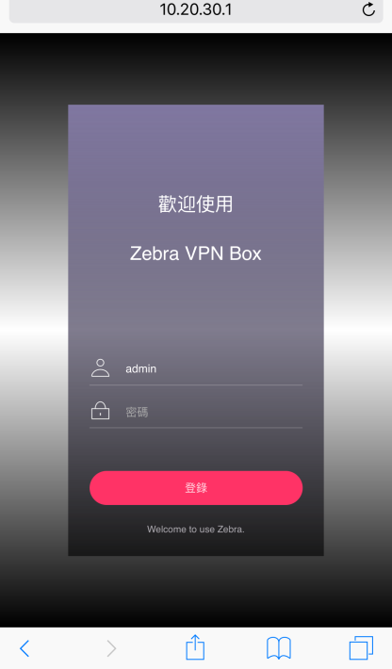

Set up VPN
❷ Set up the Mobile Phone
MiniVPN_Black
Add
① Access mobile phone settings
② Access “Wi-Fi” and turn Wi-Fi on
③ Access “Scan for Wi-Fi”
④ Search for “MiniVPN-Black-xxxxxx”
⑤ Add in “MiniVPN-Black-xxxxxx”
（Default Wi-Fi Password: 12345678）
Open the Browser and type in Black Box’s IP (Default 10.20.30.1)
or simply type in “minivpn.com”.
Then, log in to the setting page
by typing in Black Box’s password
(Default Account/Password : admin/admin)
Zebra’s Official Website：http://www.zebravpnbox.com/

Slide 4
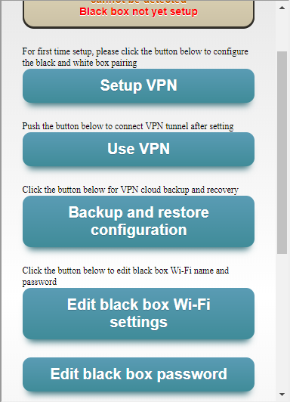
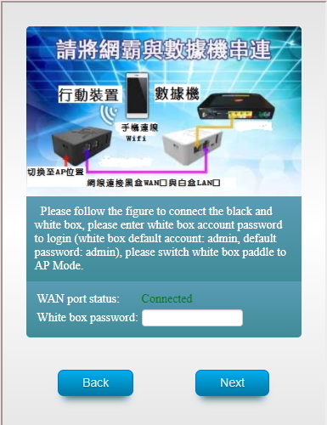

Set up VPN
❸ Set-up Procedure
Type in White Box’s password
(Default Password: admin),
and click the “Next” button to proceed.
Click “Set Up VPN” and begin setting.
Zebra’s Official Website：http://www.zebravpnbox.com/

Slide 5
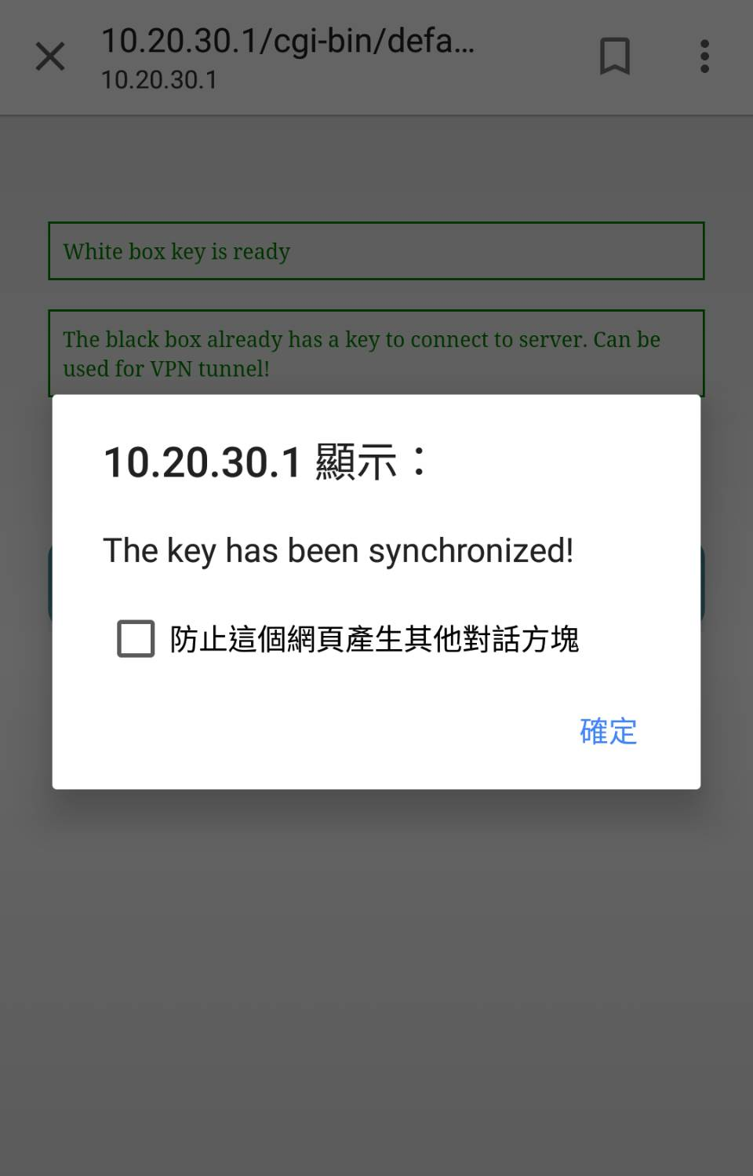
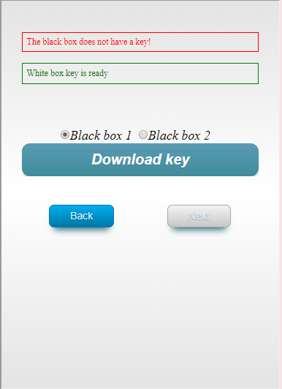
Set up VPN
❸ Set up Procedure
After White Box’s key generated, choose Black Box (1 White Box can be connected with 2 Black Boxes) and click “Download Key File”
After finishing downloading key file, click “Next” to proceed.
Zebra’s Official Website：http://www.zebravpnbox.com/

Slide 6
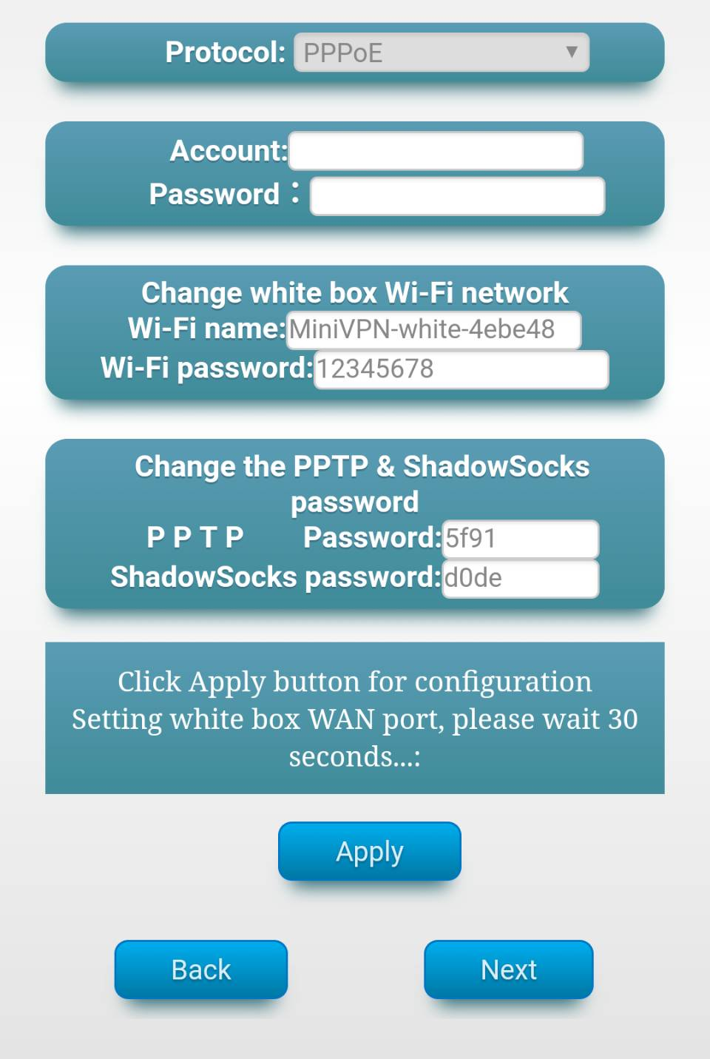
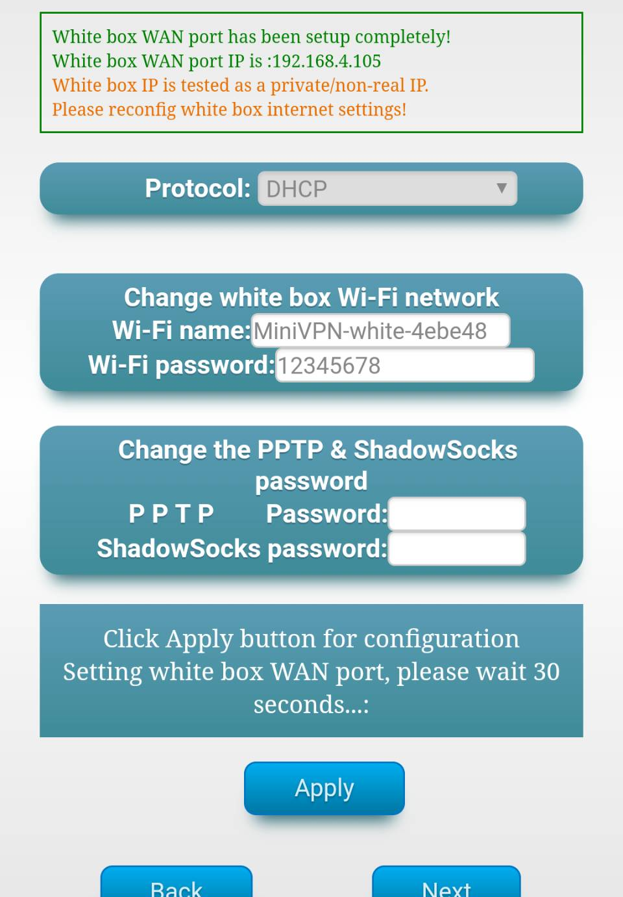
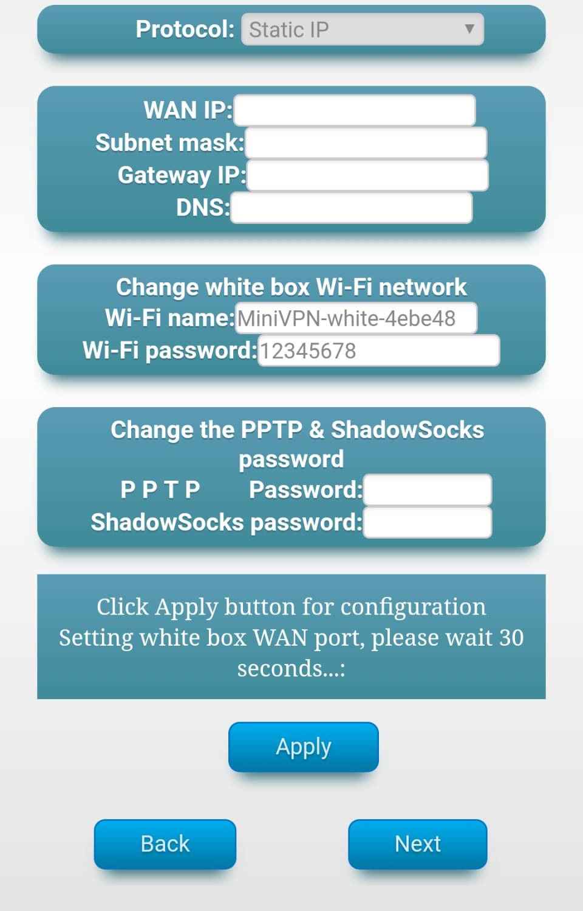
Set up VPN
❹Set up the Internet for White Box
Set up the Internet for White Box according to your internet connection. In normal circumstances, please select PPPoE for broadband Internet connections. When it’s finished, you will receive a reminder of whether your WAN port is a public IP. Click “Next” to continue.
Zebra’s Official Website：http://www.zebravpnbox.com/

Slide 7
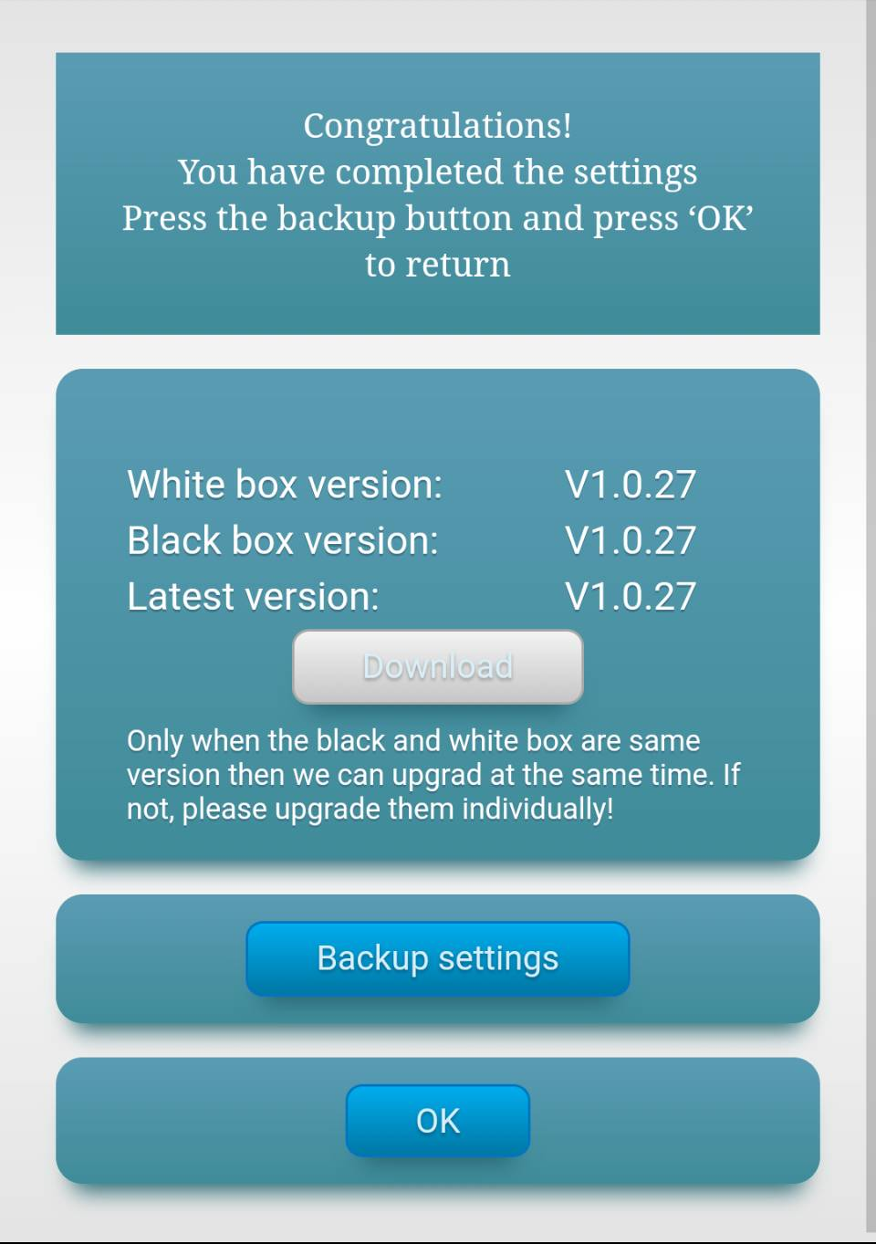
Set up VPN
❺Set-up Completed
When the set-up is completed, please remember to backup those settings (very important), and learn about the current version of both Black and White Box, in order to download the latest version for upgrades.
(Upgrading from mobile phone requires both Black and White Box be in the same version. If not, please access the UI of the routers on PC, and upgrade the firmware in System Management.)
Click the “Ok” button to return to the Main Menu. Now, you could plug off the cable between Black and White Box. Bring on the Black Box when you go out, and enjoy the personal VPN connection.
Zebra’s Official Website：http://www.zebravpnbox.com/

Slide 8
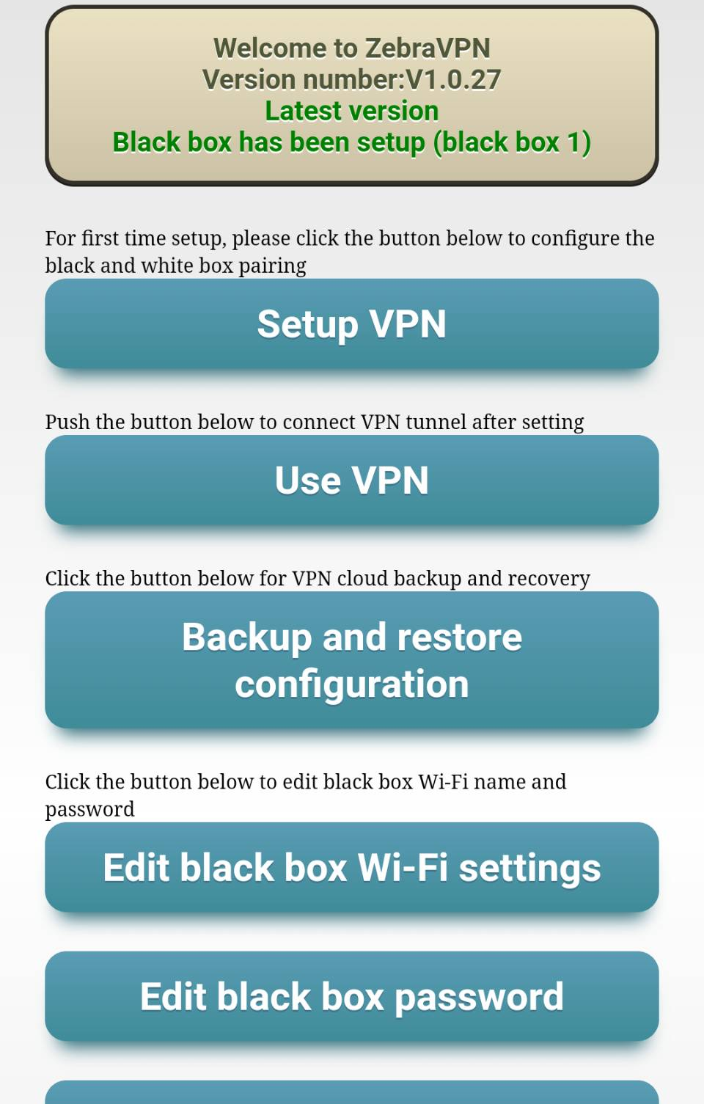
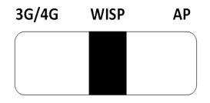
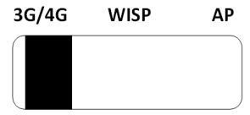

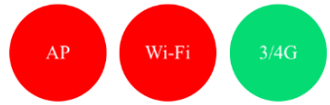
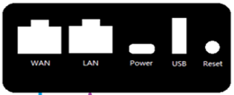

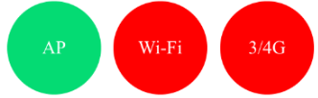
Use VPN
It automatically detects your networking mode, and shows you where the switch goes with green color.
Click “Use VPN”, and select the networking mode for Black Router.
Switch the paddle on the side of the router to sync with the networking mode.
Zebra’s Official Website：http://www.zebravpnbox.com/

Slide 9
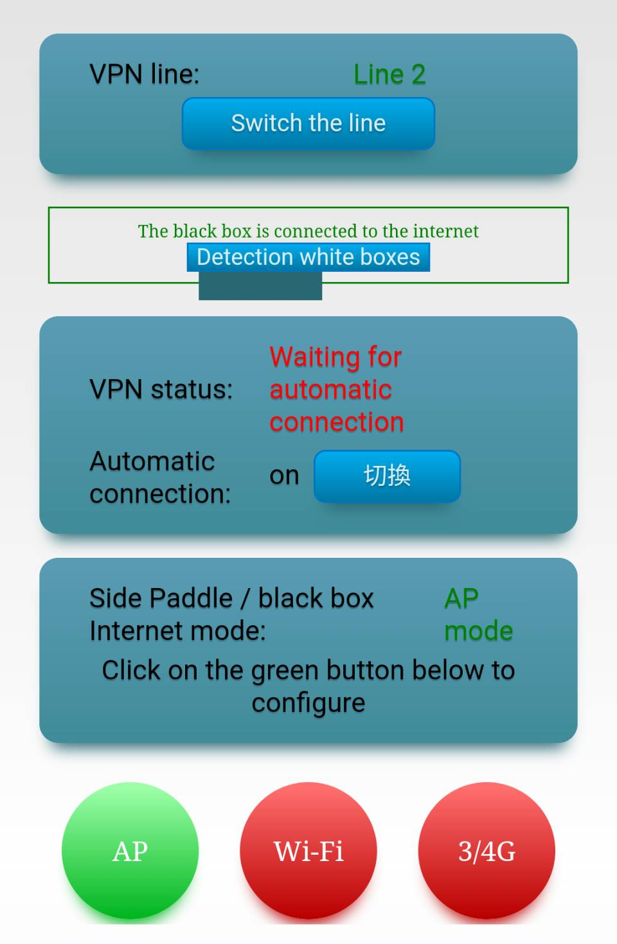
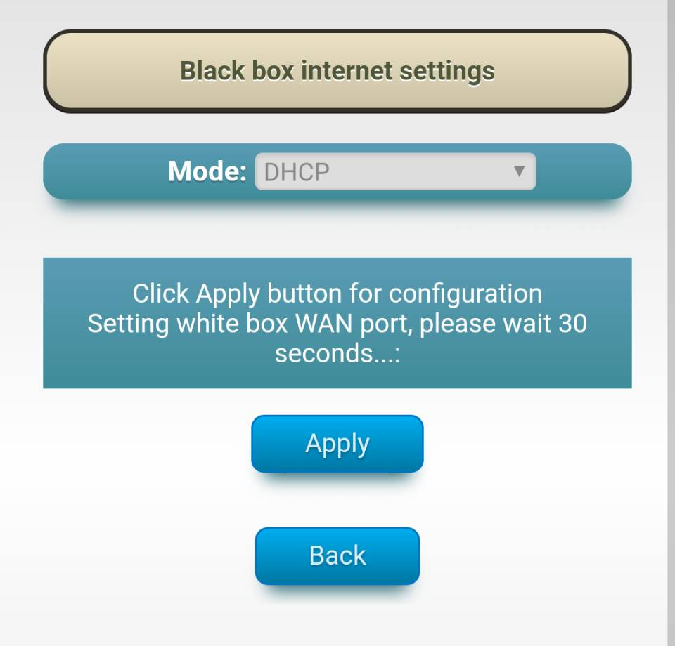


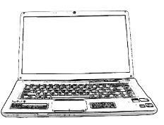

Use VPN
Figure for AP Mode Connection
Ethernet Wall Jack
or
Router’s LAN Port
Or
Apply Black Box to wired internet connection. Switch the side paddle to “AP”. As the AP button turned green, click it to access Settings.
Choose the wired connection that corresponds to yours. Setup the internet connection for Black Box.
Zebra’s Official Website：http://www.zebravpnbox.com/

Slide 10
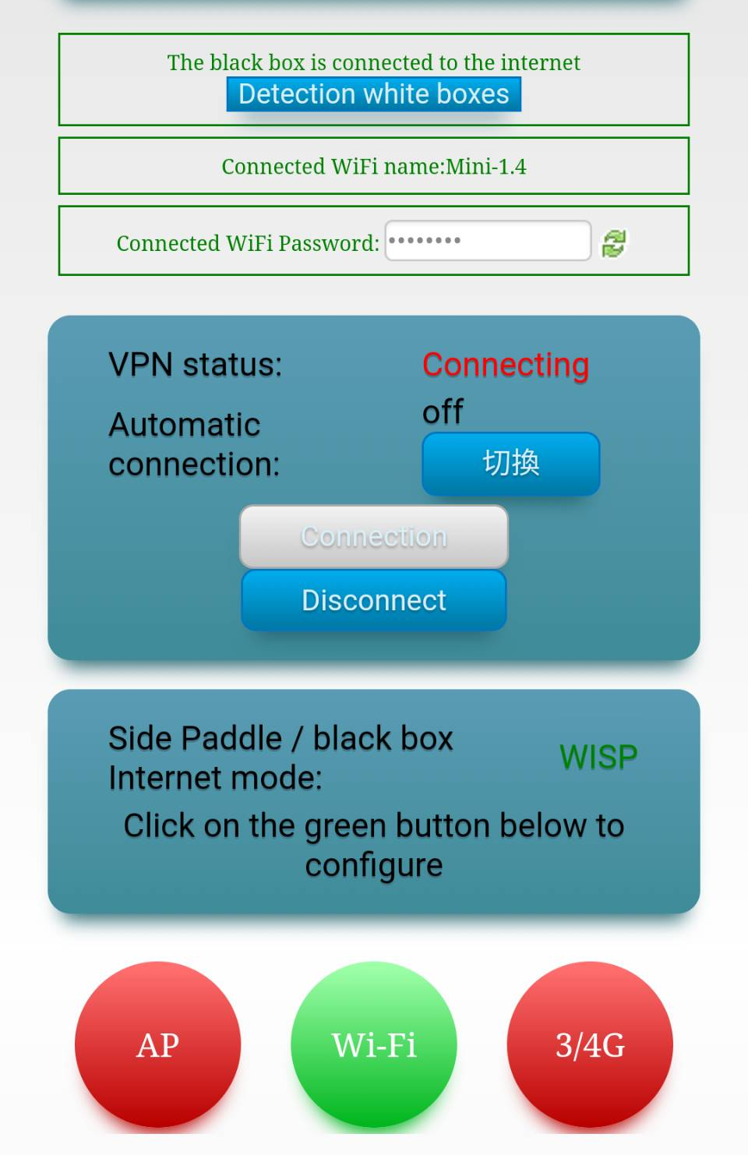
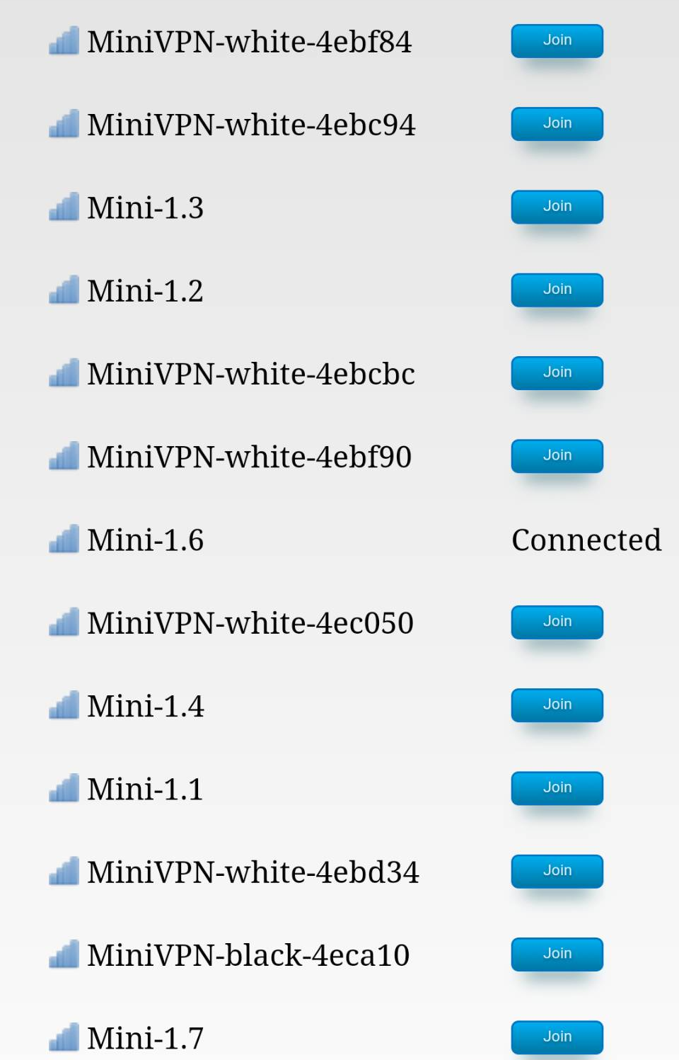



Use VPN
Figure for WISP Mode Connection
●The Black Box will automatically memorize the password of previous Wi-Fi connections.
Apply Black Box to wireless internet connection.
Switch the side to “WISP”.
As the Wi-Fi button turns green, click it to access settings.
Select the correct Wi-Fi name and type in the password. Click the “Connect” button to connect to the Internet.
●If the Wi-Fi disconnects afterwards, please wait for 30 sec and reconnect to Black Box.
Zebra’s Official Website：http://www.zebravpnbox.com/

Slide 11
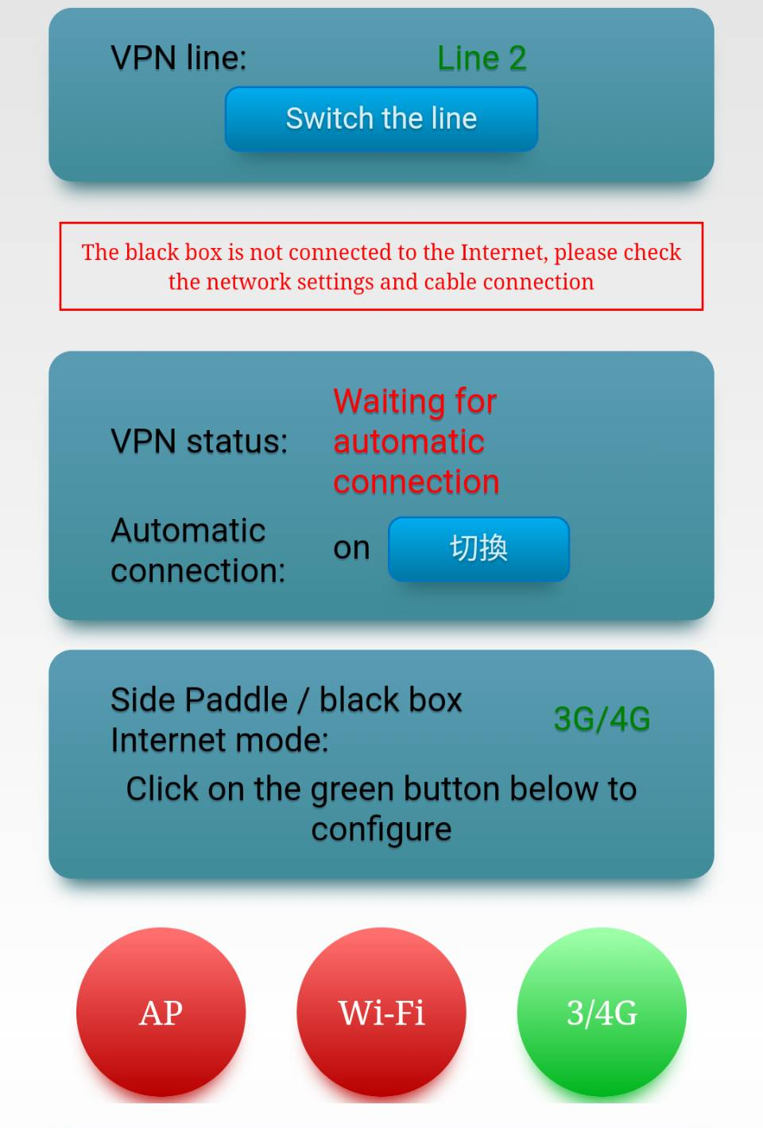
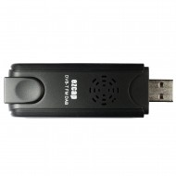

Use VPN
Figure for 3G/4G Mode Connection
Apply Black Box to 3G/4G network card connection.
Flip the side paddle to “3G/4G”.
As the “3G/4G” button turns green, insert 3G/4G network card to connect to the Internet.
Zebra’s Official Website：http://www.zebravpnbox.com/

Slide 12
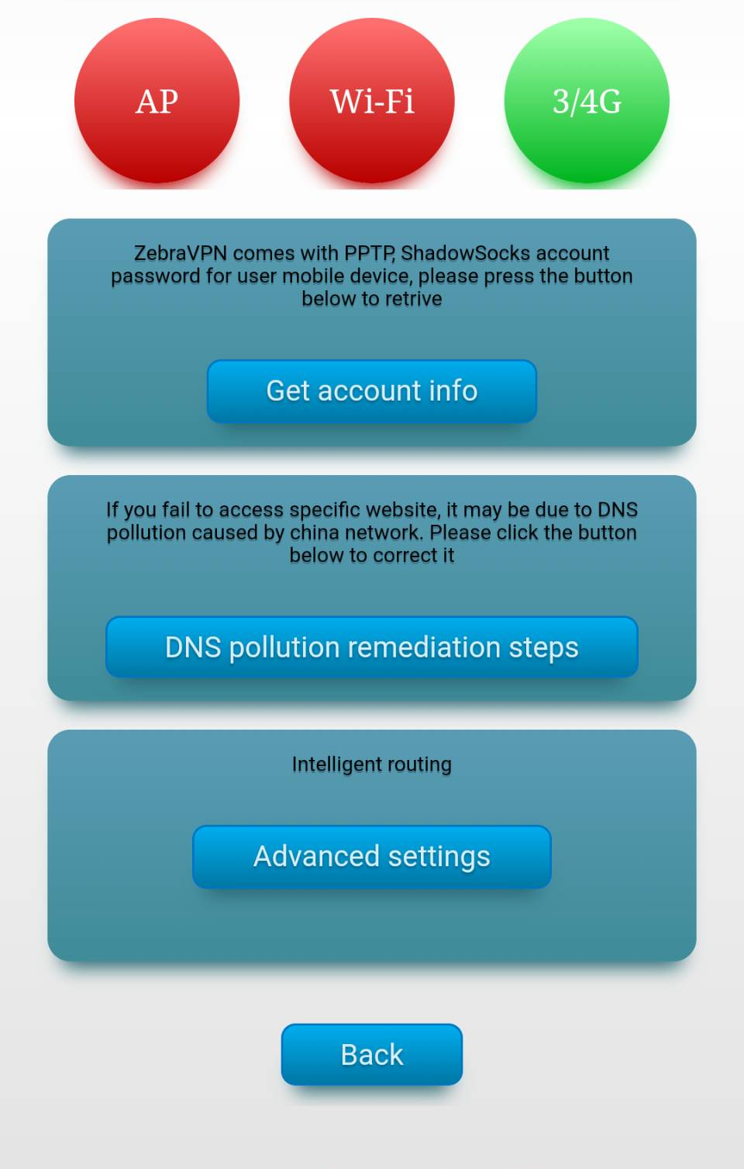
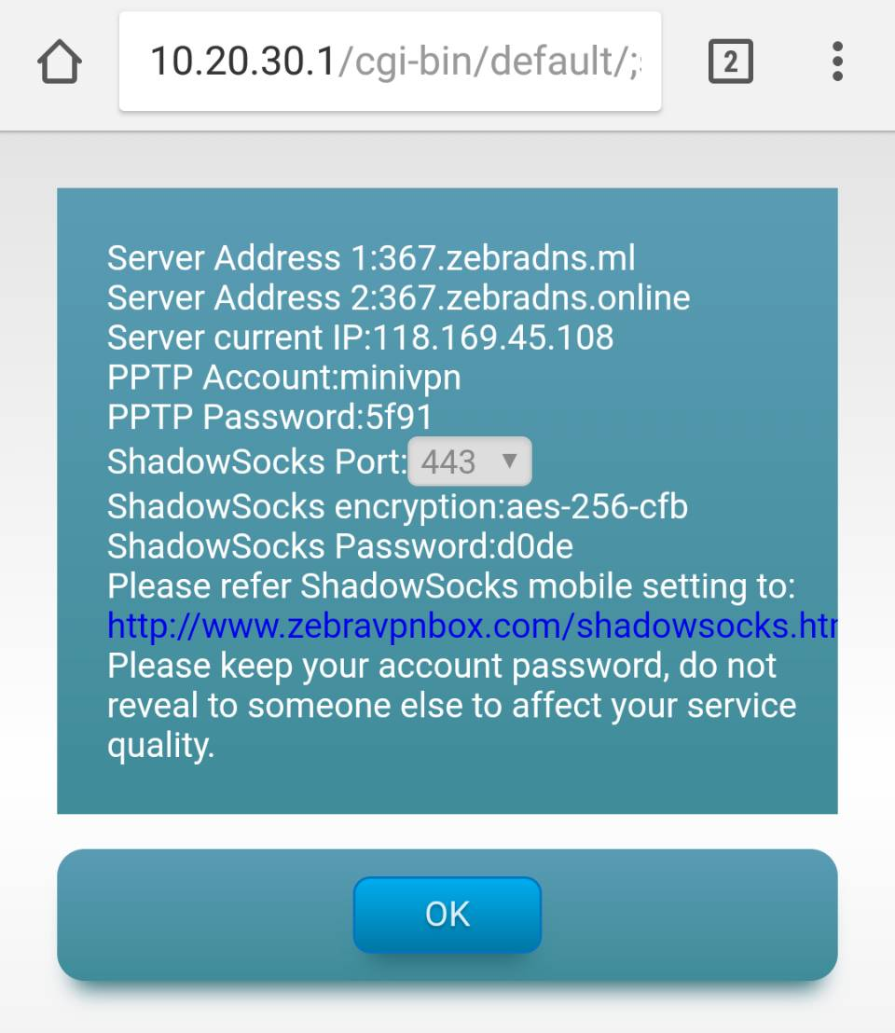

Use VPN
Direct access from PPTP to APP VPN
The router provides an PPTP account and password for users to connect their portable device with White Box. Get the account by clicking on the “Get Account” button. An account and password is also provided for users to connect their mobile phone’s APP with White Box. For more details, please visit our website.
www.zebravpnbox.com/Shadowsocks.html
Zebra’s Official Website：http://www.zebravpnbox.com/

Slide 13
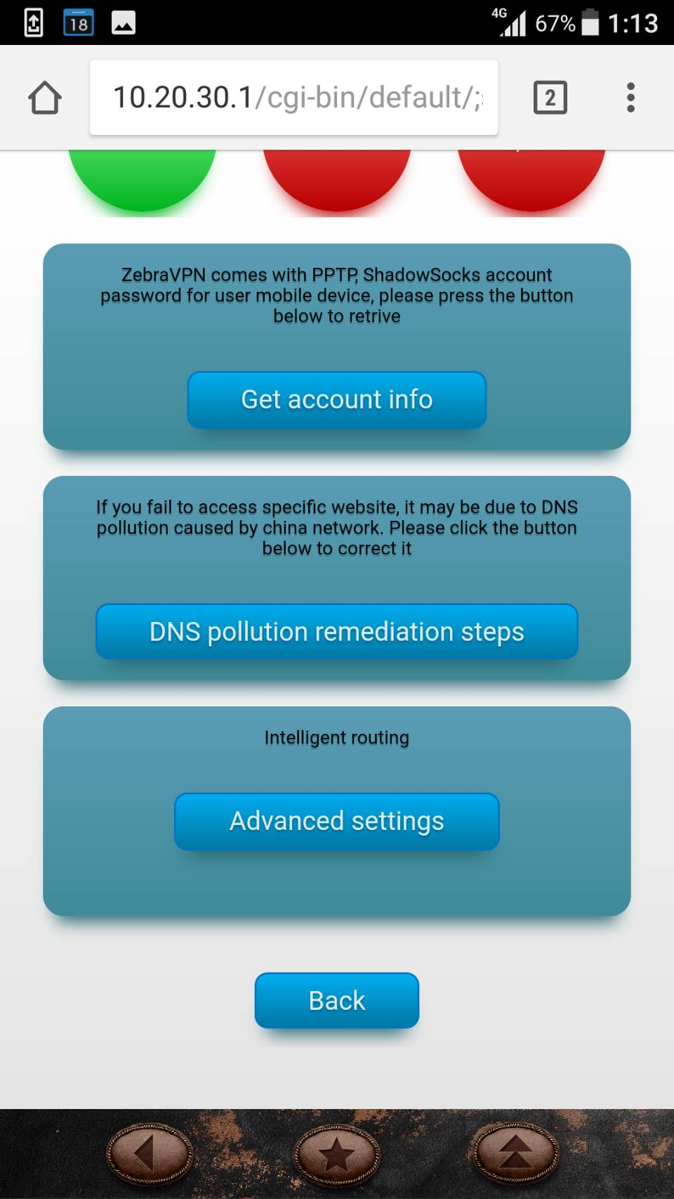
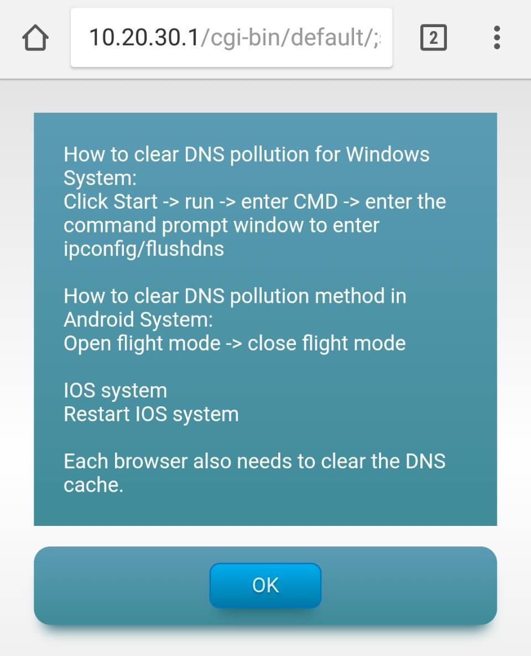
Use VPN
DNS Pollution
Remediation Steps
If you are not able to access some of the websites due to DNS Hijacking, click ”DNS pollution remediation steps”, and it will show you how to clear DNS cache.
Zebra’s Official Website：http://www.zebravpnbox.com/

Slide 14
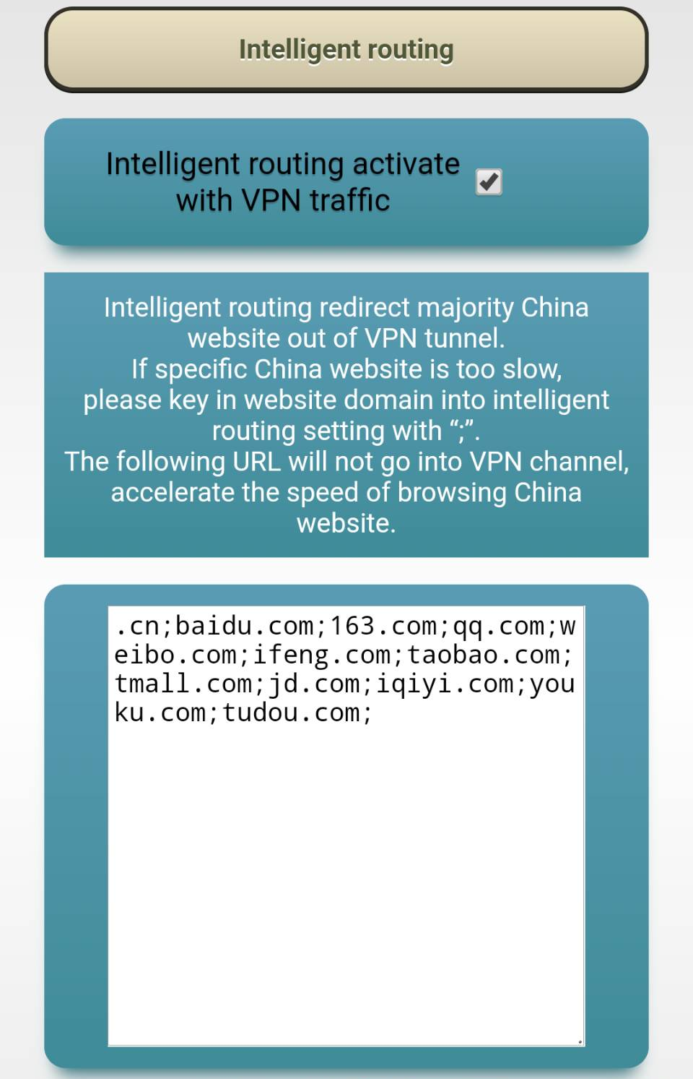
Use VPN
Intelligent Routing
Intelligent routing uses Virtual Address Separation, the default setting includes majority China websites. You could also add in your favorite websites.
Zebra’s Official Website：http://www.zebravpnbox.com/

Slide 15
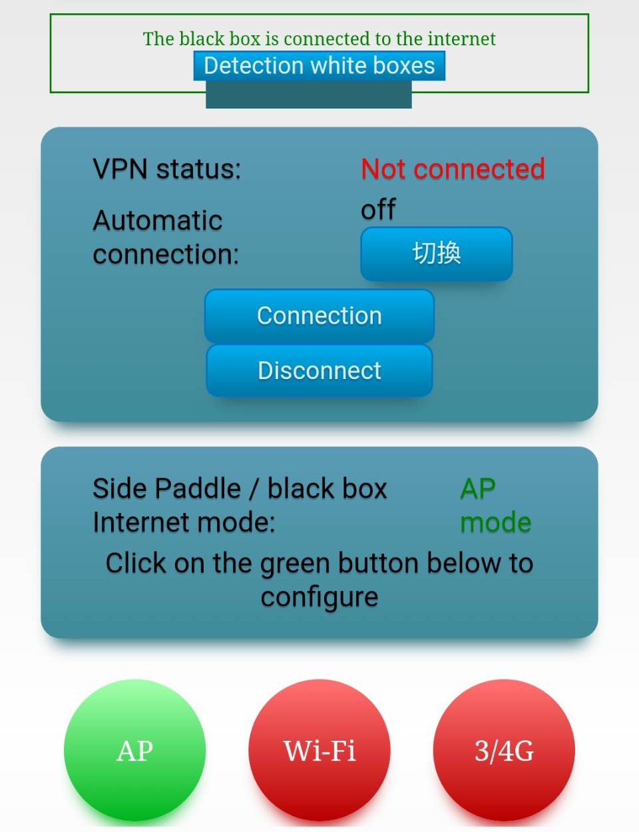
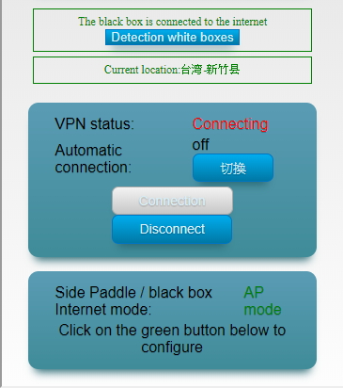

Use VPN
Connect to VPN
If VPN remains unconnected after the Black Box connected to the internet, click the “Connect” button to access VPN.
When it’s done, you will get the location of Black Box, and the duration of VPN delay between Black and White Box in real-time.
At this point, you’ve finished the connection.
Zebra’s Official Website：http://www.zebravpnbox.com/

Slide 16
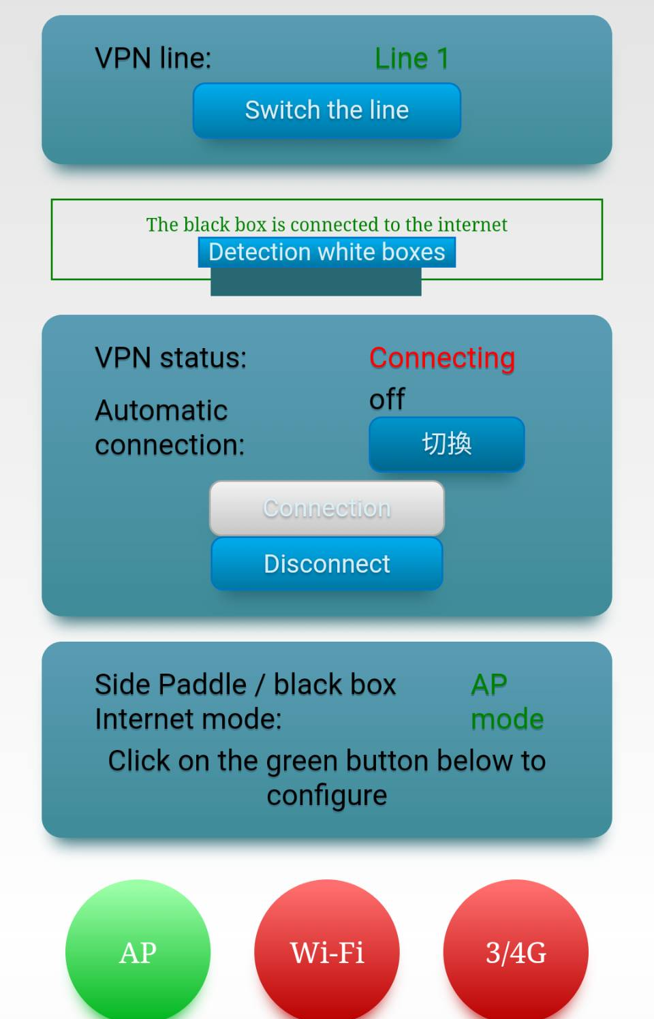
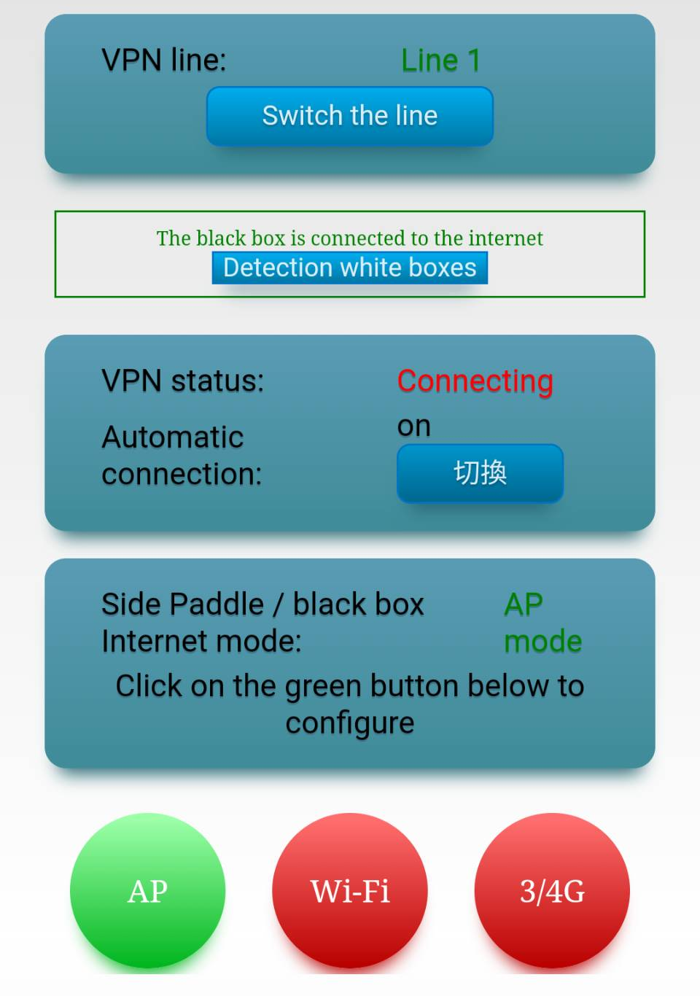
Use VPN
Automatic VPN Connection and Optimization
In the VPN interface, there is a “Auto-connect” button. As the “Auto-connect” is turned on, it helps you to connect to VPN automatically, and optimize your VPN when issues occur.
Zebra’s Official Website：http://www.zebravpnbox.com/

Slide 17
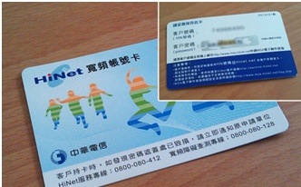
Q: Is there any restrictions on setting up VPN in Taiwan?
A: Setting up a personal VPN requires public IP in Taiwan. Please confirm with Chunghwa Telecom. In general circumstances, Chunghwa Telecom and TFN users are able to access public IP. If you’re not sure about whether your internet service includes access to public IP, please contact your internet service provider.
Q: Do I need public IP when using Black Box in China?
A: No, it’s not necessary. Public IP is required when using White Box in Taiwan. As for Black Router, as long as it’s connected to the internet from either Wi-Fi, wired internet, or 4G internet card (Huawei E3372h-607), you can connect to VPN through White Box.
Q: How do Chunghwa Telecom users setup PPPoE account and password for Black and White Box?
A: The following picture shows the Hinet ADSL Card.
PPPoE Account = XXXXXX@hinet.net XXXXXX=Client Number(Portable Public IP)
PPPoE Account = XXXXXX@ip.hinet.net XXXXXX=Client Number(Static Public IP)
PPPoE Password = Client Number
Common Questions
Zebra’s Official Website：http://www.zebravpnbox.com/

Slide 18
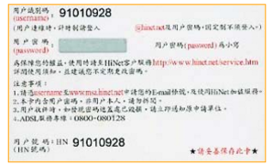
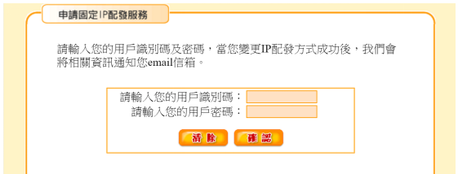
Q: Between portable and static public IP, which one goes well with Black and White Box?
A: Black Box and White Box with static public IP provides the most stable internet connection in China, requiring Chunghwa Telecom application for internet services.
1.Hinet : http://service.hinet.net/2004/adslstaticip.php
2.Sonet : http://www.so-net.net.tw/service/member/pppoe_fixip.htmloff120521
For instance, here is a tutorial for Chunghwa Telecom.
Step 1. First, access Chunghwa Telecom’s application page for static IP. Then, click “I agree to the terms of service” at the bottom.
Step 2. Next, type in client number(HN Number) and client password that is written on the back of Hinet ADSL card as the following picture.
Step 3. Then, you can see the condition of IP, indicating “8 Portable IP”. Click “Change into 1 Static IP + 7 Portable IP” and type in your E-mail address in the “E-mail” section (When the application is finished, information for static IP will be sent to your e-mail address for backup). At last, Click the “Confirm” button.
Step 4. Finally, the settings are done.
Common Questions
Zebra’s Official Website：http://www.zebravpnbox.com/

Slide 19
Common Questions
Q: As the application for static IP is finished, how do I change the dial-up internet setting, in order to gain access to stable public IP?
A: To access to static IP, the process of dialing up might slightly change. For Chunghwa Telecom users, if you were using “12345678@hinet.com” as your dial-up account to get a “Portable IP Address”, now, you need to change it into “12345678@ip.hinet.com” . Have you noticed the differences?
Simply add in “ip.” into the dial-up account, the IP you get will become your personal stable IP.
Sonet is the same as well. You can also get a static IP by dialing up “Account name@ip.so-net.net.tw”.
Q: What if I forget my password?
A: Router’s default user name:admin, password: admin. By long pressing the reset button, settings will be reset.
Q:Can I use it without AC power?
A:Yes, you can. You are able to use MiniVPN Router + portable charger （5V2A）+3G/4G dongle to access the internet.
Please access our website for more questions.
Zebra’s Official Website：http://www.zebravpnbox.com/

Slide 20
Federal Communication Commission Interference Statement
This equipment has been tested and found to comply with the limits for a Class B digital device, pursuant to Part 15 of the FCC Rules.
These limits are designed to provide reasonable protection against harmful interference in a residential installation.
This equipment generates, uses and can radiate radio frequency energy and, if not installed and used in accordance with the instructions,
may cause harmful interference to radio communications. However, there is no guarantee that interference will not occur in a particular installation.
If this equipment does cause harmful interference to radio or television reception, which can be determined by turning the equipment off and on,
the user is encouraged to try to correct the interference by one of the following measures:
● Reorient or relocate the receiving antenna.
● Increase the separation between the equipment and receiver.
● Connect the equipment into an outlet on a circuit different from that to which the receiver is connected.
● Consult the dealer or an experienced radio/TV technician for help.
FCC Caution: Any changes or modifications not expressly approved by the party responsible for compliance could void the user’s authority to operate this equipment.
This device complies with Part 15 of the FCC Rules. Operation is subject to the following two conditions:
This device may not cause harmful interference, and
This device must accept any interference received, including interference that may cause undesired operation.
For product available in the USA/Canada market, only channel 1~11 can be operated. Selection of other channels is not possible.
FCC Radiation Exposure Statement:
This equipment complies with FCC radiation exposure limits set forth for an uncontrolled environment.
This equipment should be installed and operated with minimum distance 20cm between the radiator & your body.
(1) Type approval for low-power radio-frequency devices. Any modification on frequency, power boost or property and function from original design without approval is not permitted.
(2) The usage of low-power radio-frequency devices should not endanger flight safety or interfere with legal telecommunication. If telecommunication interference is found, one should stop using the device immediately. Legal telecommunication refers to wireless communication under telecommunication policy.
Low-power radio-frequency devices should be capable to endure interference from legal telecommunication or industrial, scientific, medical Radiological Exposure Devices.
(3) “Radiation exposure MPE standards :1mW/cm², estimation report for the product: 0.0799 mW/cm² “

