Slide 1

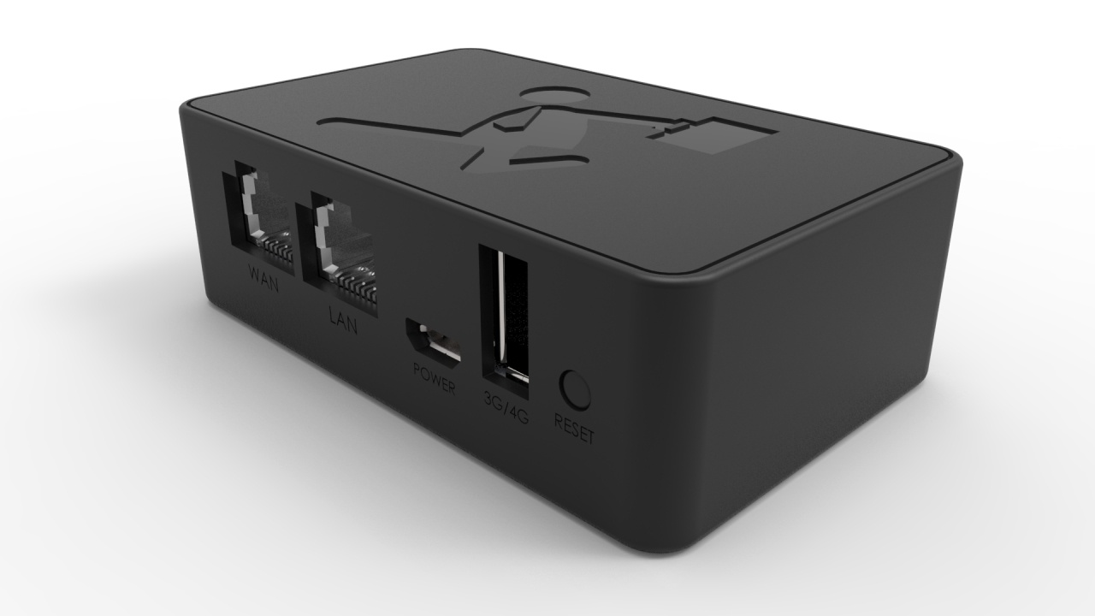
Zebra’s Official Website：http://www.zebravpnbox.com

Slide 2
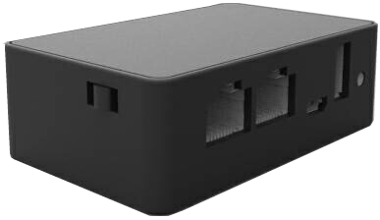
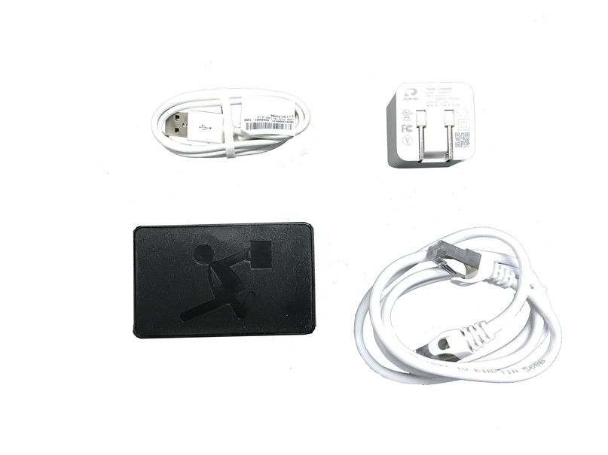
Zebra Hotspot Global Project Package User’s Guide
After receiving Zebra Hotspot Global Project Package(including a Black Box, an Ethernet cable, a USB cable, and a transformer) . In order to enable Black Box’s internet connection, please change the mode by flipping the side paddle.
Three networking modes are provided. Please choose the one that fits your needs.
AP Mode – DHCP Client Mode
PPPoE Mode
Static IP Mode
AP Mode means direct internet connection from Black Box’s WAN port to routers / modems’s LAN port（Direct internet connection through default DHCP IP address is available. Individual modem requires a PPPoE dial up connection）
Mode Switch
WISP Mode – AP Client Mode
WISP Mode means Black Box connects to Wi-Fi through wireless connection.
3G / 4G Mode
3G/4G Mode means apply the dongle connected to your phone that provides 4G service onto Black Box, which enables internet connection through Black Box.
Zebra’s Official Website：http://www.zebravpnbox.com

Slide 3
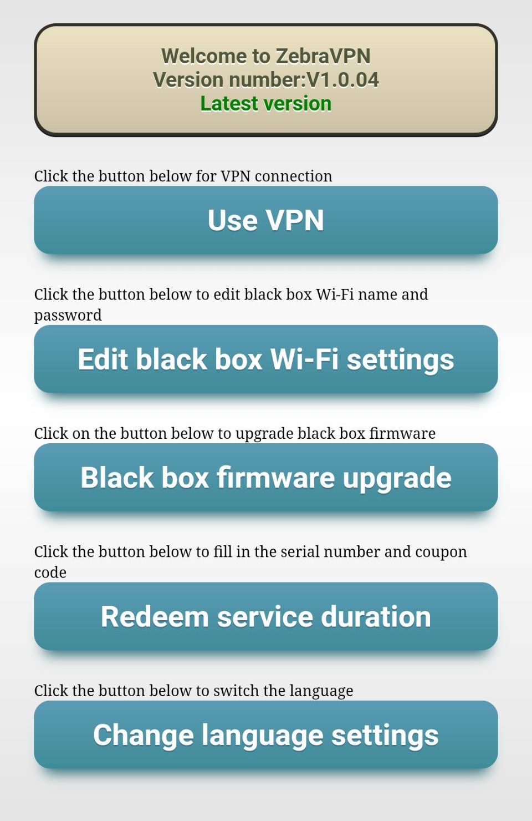
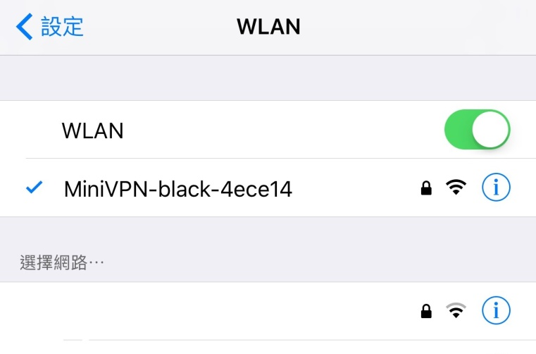

Setup VPN
Set up the mobile phone
① Access mobile phone settings
② Access “Wi-Fi” and turn Wi-Fi on
③ Access “Scan for Wi-Fi”
④ Search for “MiniVPN-Black-xxxxxx”
⑤ Add in “MiniVPN-Black-xxxxxx”
（Default Wi-Fi Password: 12345678）
Open the browser and type in Black Box’s IP
(Default 10.20.30.1)
or simply type in “minivpn.com”.
Zebra’s Official Website：http://www.zebravpnbox.com

Slide 4

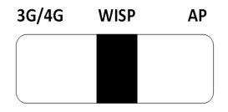
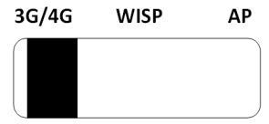


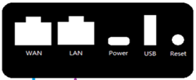
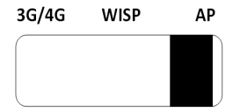

Use VPN
It automatically detects your networking mode, and shows you where the switch goes with green color.
Click “Use VPN”, and select the networking mode for Black Box.
Switch the side paddle to sync with the networking mode.
Zebra’s Official Website：http://www.zebravpnbox.com

Slide 5
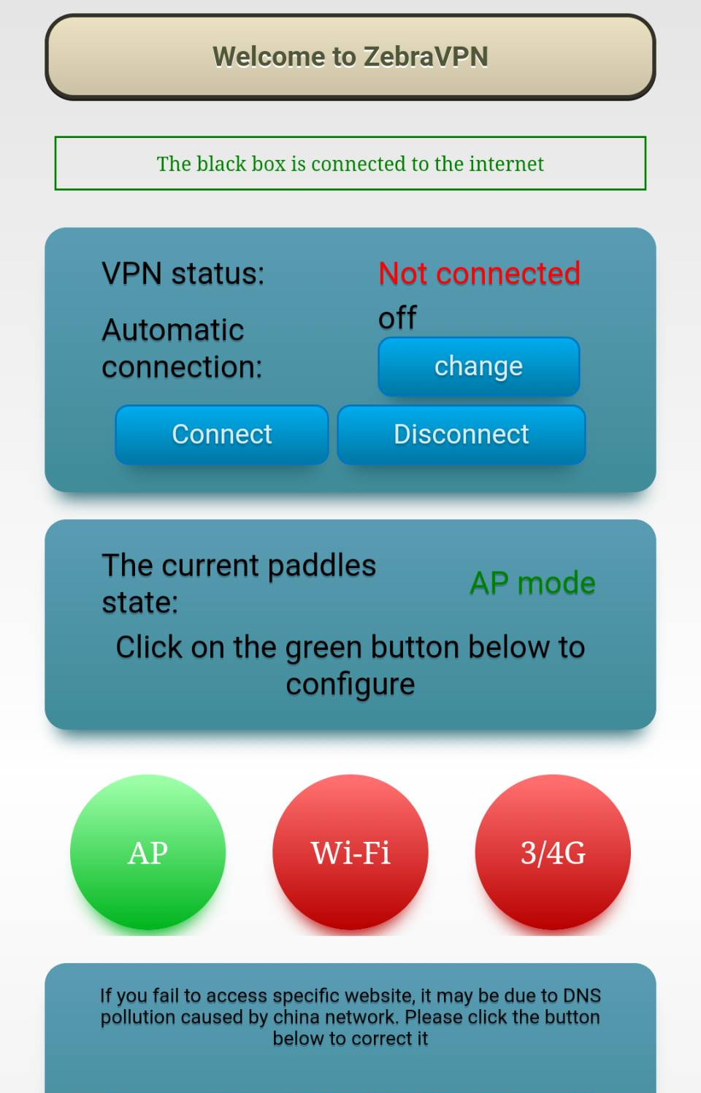
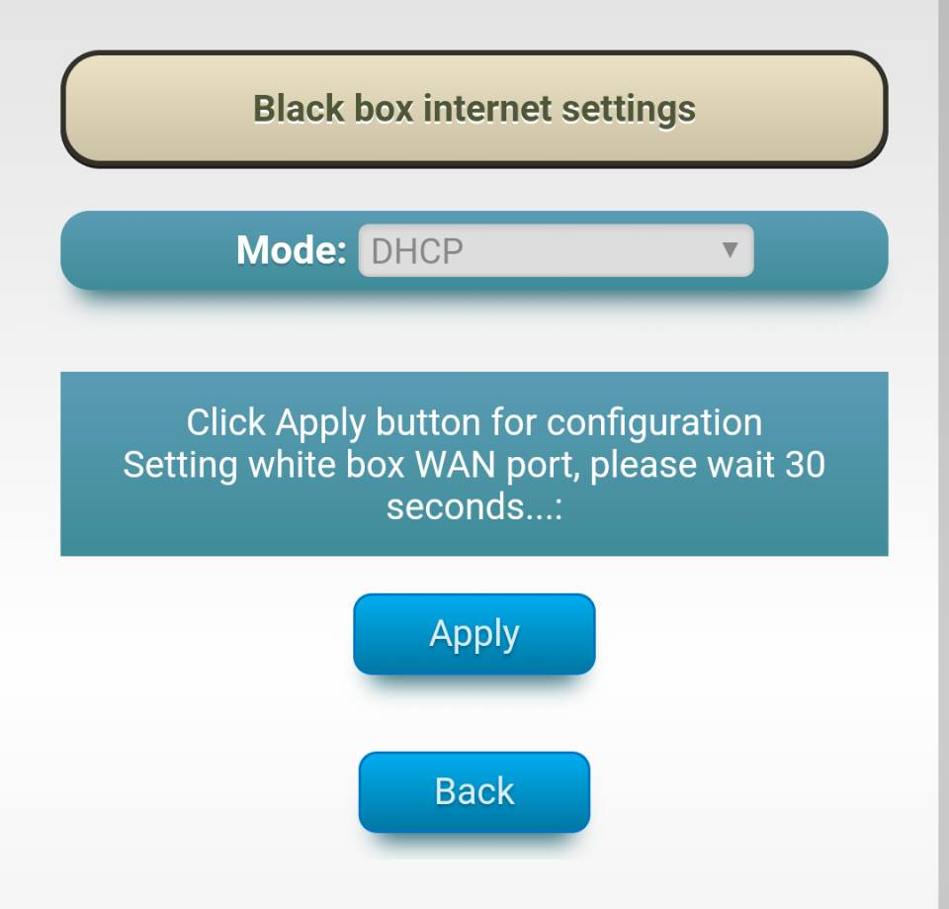


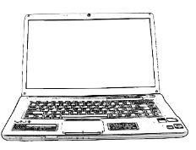

Use VPN
Diagram for AP Mode Connection
Ethernet Wall Jack
or
Router’s LAN Port
Or
Apply Black Box to wired internet connection.
Switch the side paddle to “AP”.
As the AP button turned green, click it to access Settings.
Choose the wired connection that corresponds to yours. Setup the internet connection for Black Box.
Zebra’s Official Website：http://www.zebravpnbox.com

Slide 6
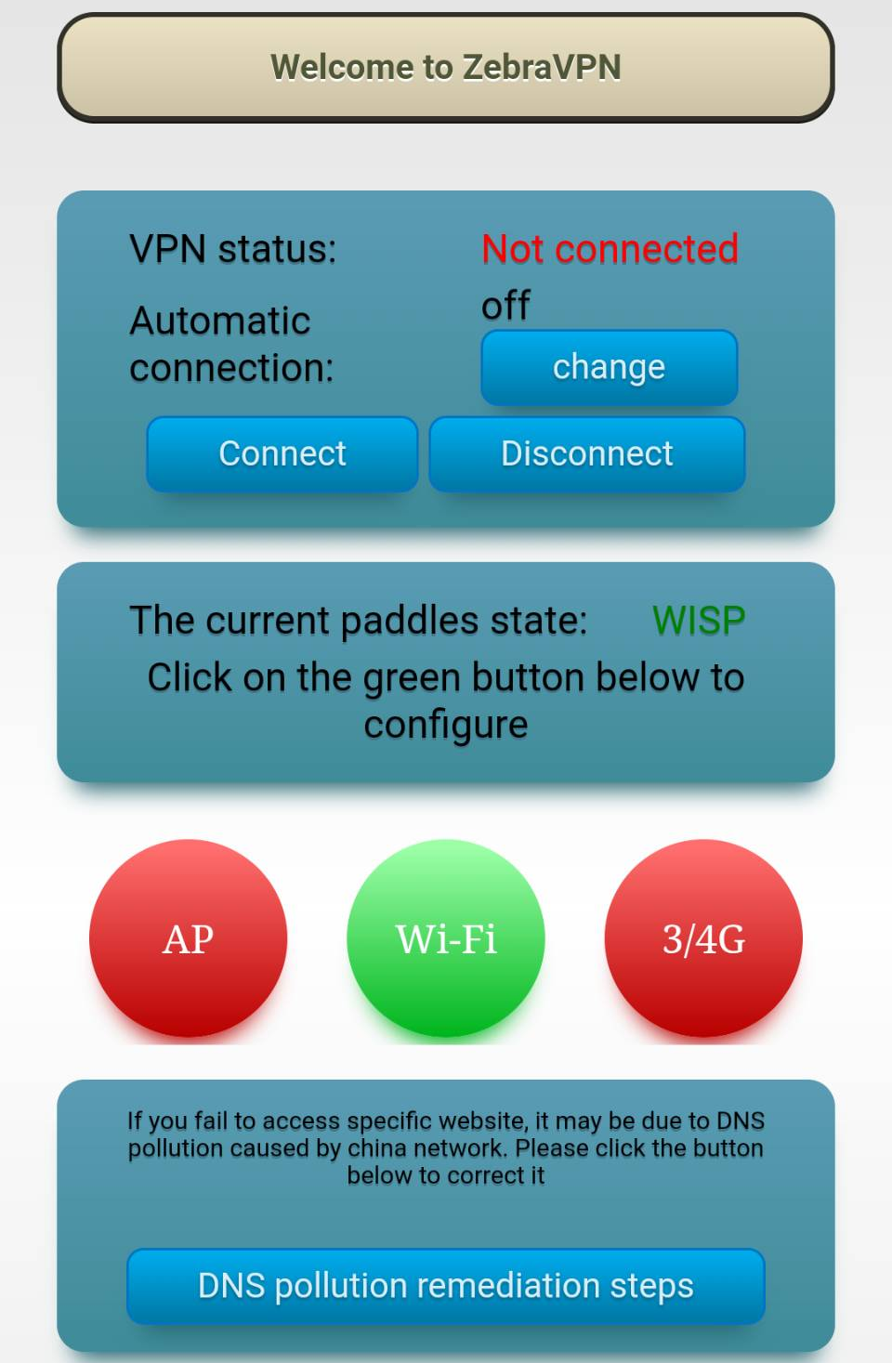
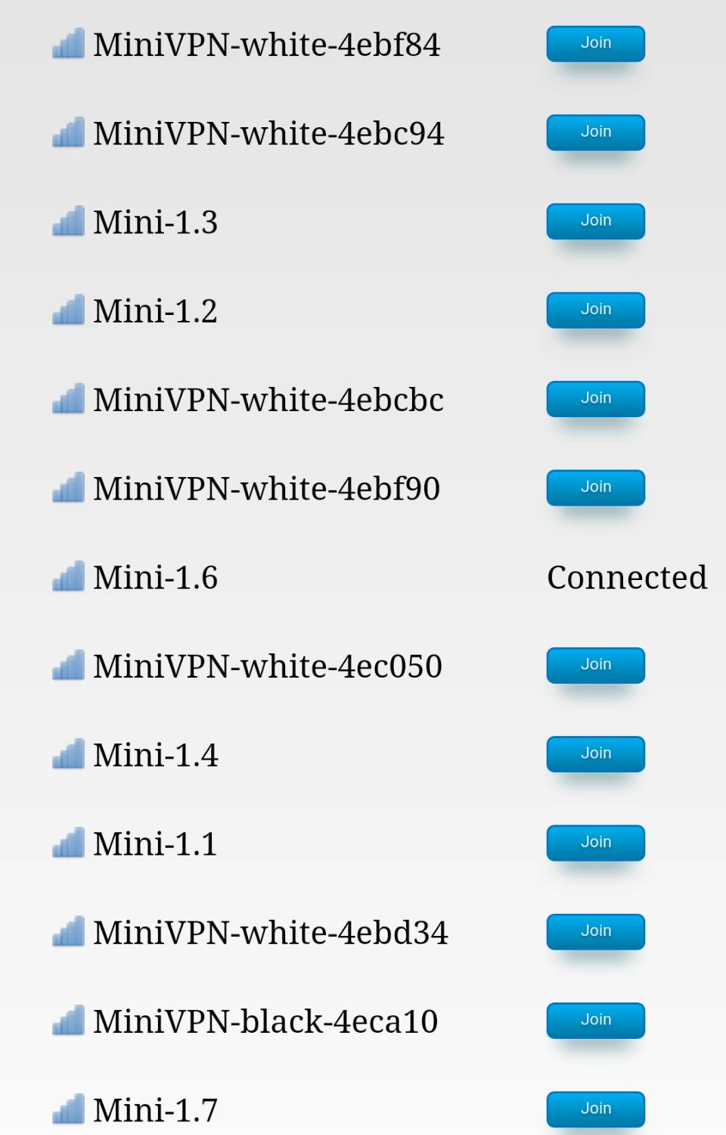



Use VPN
Diagram for WISP Mode Connection
●The Black Box will automatically memorize the password of previous Wi-Fi connections.
Apply Black Box to wireless internet connection.
Switch the side paddle to “WISP”.
As the Wi-Fi button turns green, click it to access Settings.
Select the correct Wi-Fi name and type in the password. Click the “Connect” button to connect to the Internet.
●If the Wi-Fi disconnects afterwards, please wait for 30 sec and reconnect to Black Box.
Zebra’s Official Website：http://www.zebravpnbox.com

Slide 7
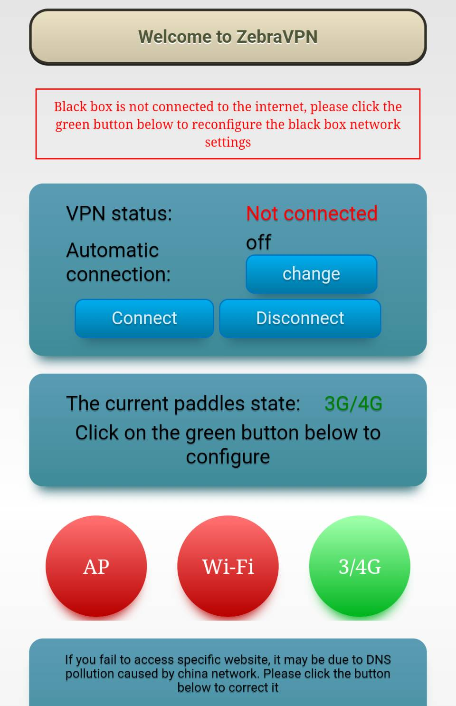

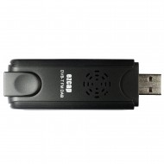

Use VPN
Diagram for 3G/4G Mode Connection
Apply Black Box to 3G/4G network card connection.
Switch the side paddle to “3G/4G”.
As the “3G/4G” button turns green, insert 3G/4G network card to connect to the Internet.
Zebra’s Official Website：http://www.zebravpnbox.com

Slide 8
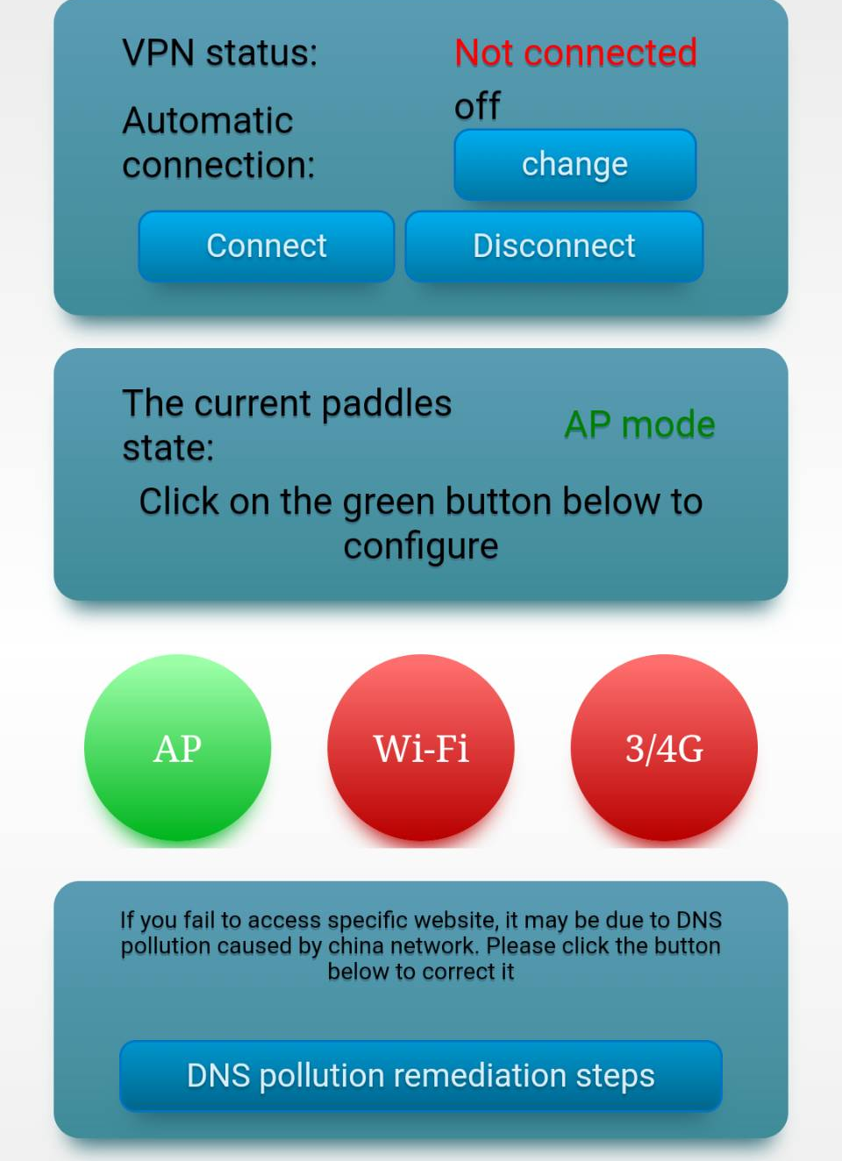
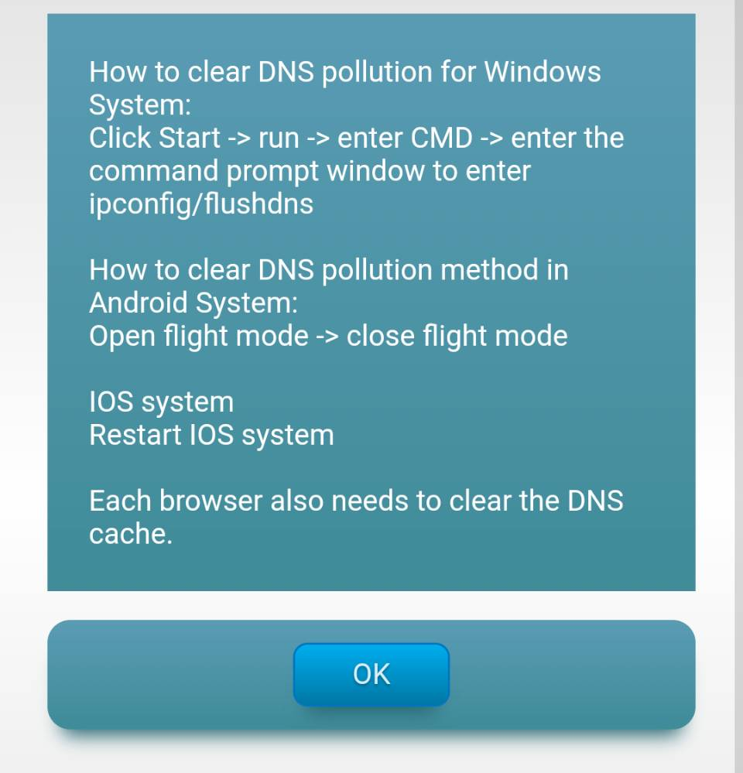

Use VPN
DNS Pollution Remediation Steps
If you are not able to access some of the websites due to DNS Hijacking, click ”DNS Pollution Remediation Steps”, and it will show you how to clear DNS cache.
Zebra’s Official Website：http://www.zebravpnbox.com

Slide 9
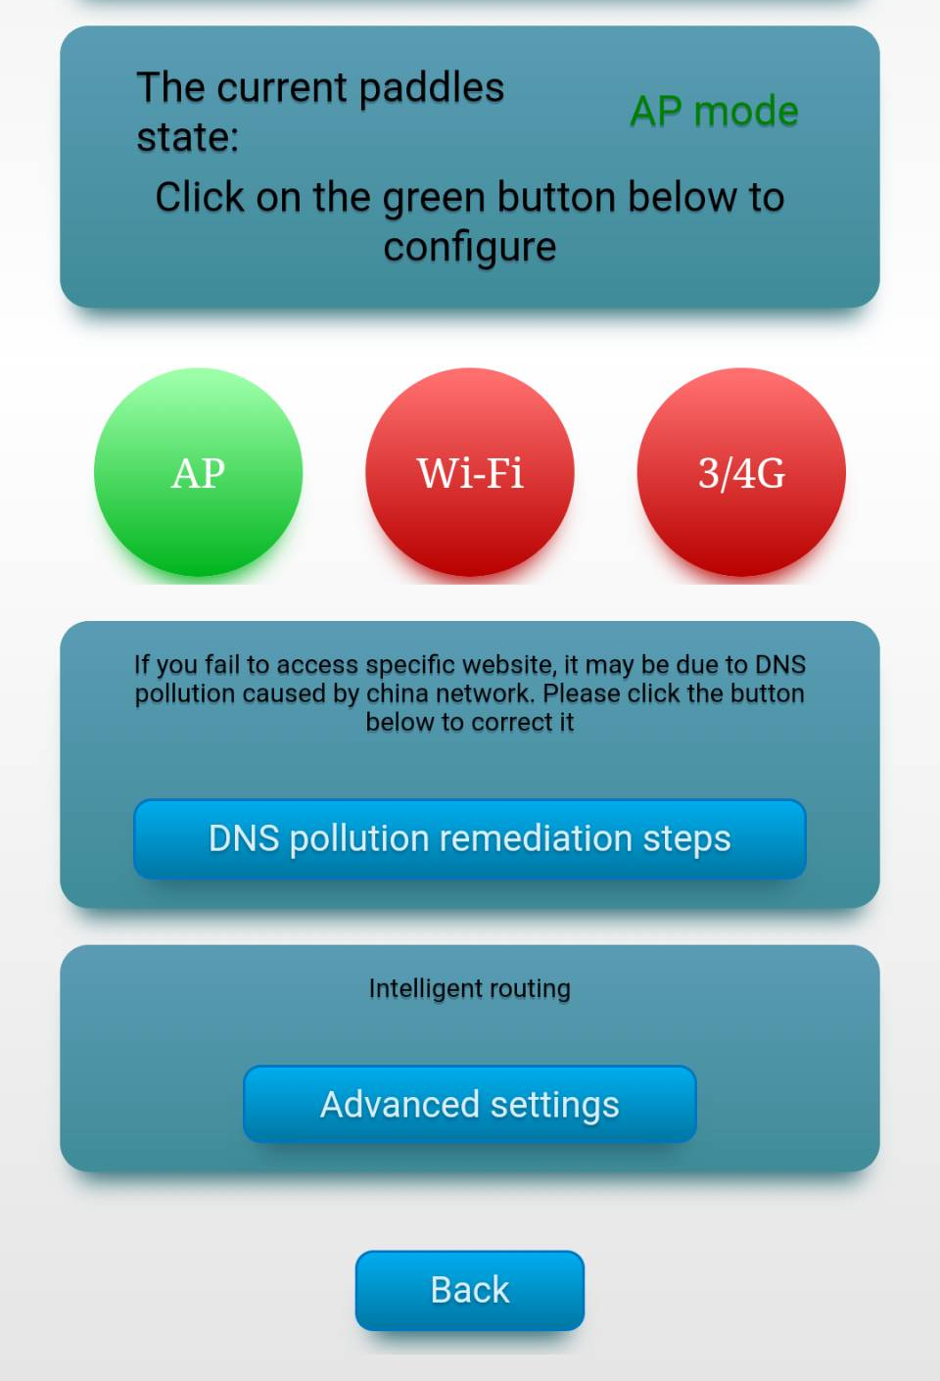
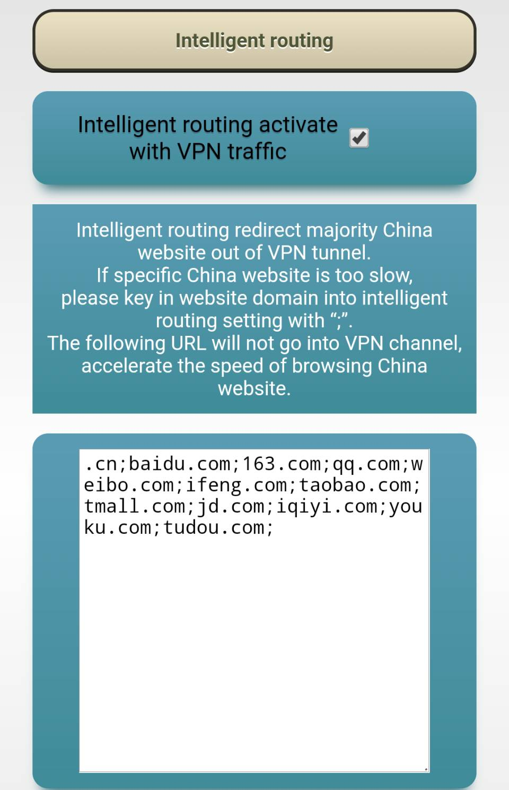
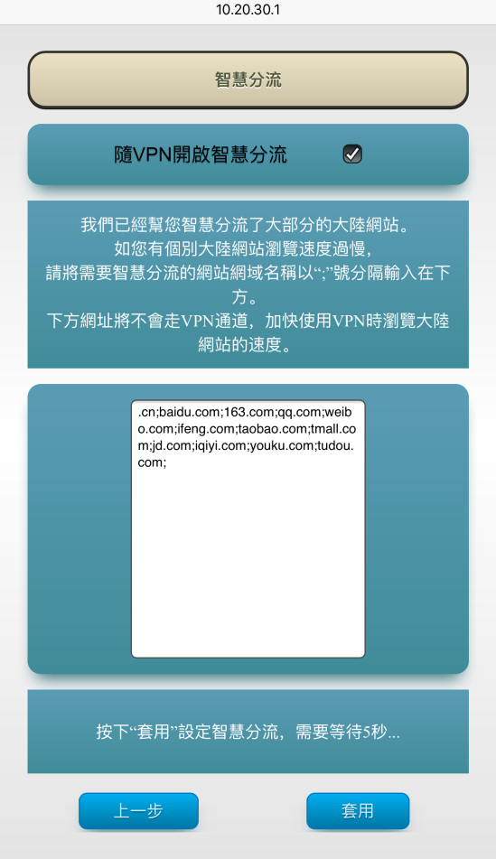
Use VPN
Intelligent Routing
Smart VPN Separation uses Virtual Address Separation, the default setting includes China’s mainstream website. You could also add in your favorite websites.
Zebra’s Official Website：http://www.zebravpnbox.com

Slide 10
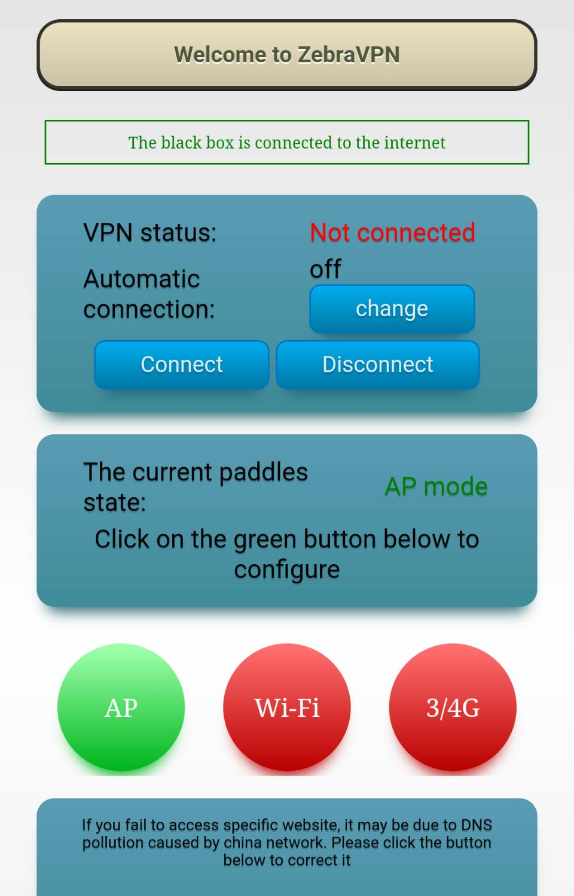
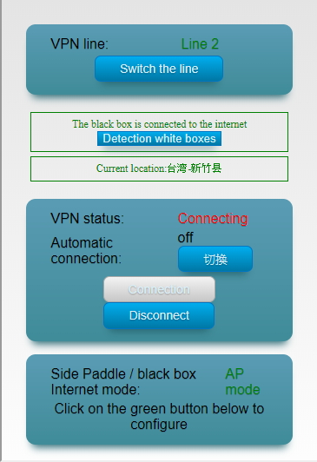

Use VPN
Connect to VPN
If VPN remains unconnected after the Black Box connected to the internet, click the “Connect” button to access VPN.
When it’s done, you will get the location of Black Box, and the remain time for the plan.
At this point, you’ve finished the connection.
Zebra’s Official Website：http://www.zebravpnbox.com

Slide 11

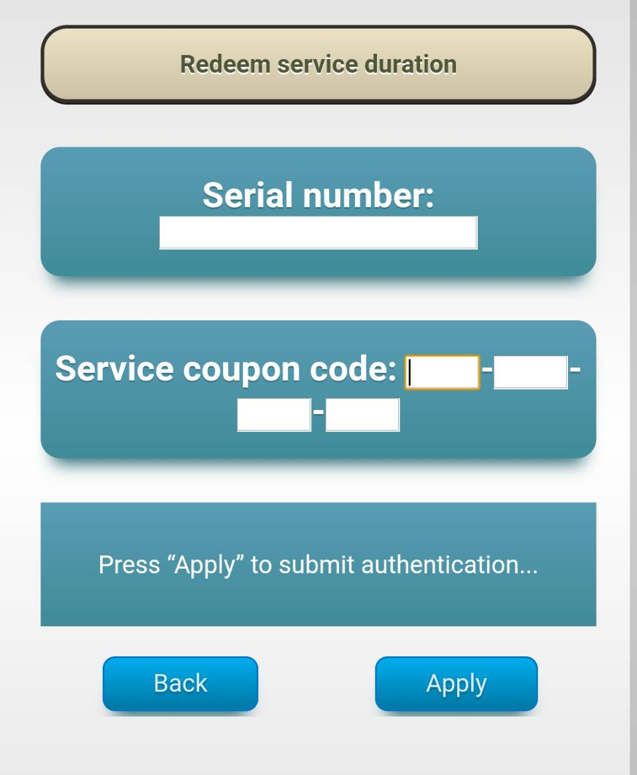
Redeem Service Duration
If the service duration runs out, please purchase the serial number and service coupon code by contacting the customer service via WeChat or Line（ID：zebravpnbox). Please redeem your code as the picture that shows above.
Zebra’s Official Website：http://www.zebravpnbox.com

Slide 12
Federal Communication Commission Interference Statement
This equipment has been tested and found to comply with the limits for a Class B digital device, pursuant to Part 15 of the FCC Rules.
These limits are designed to provide reasonable protection against harmful interference in a residential installation.
This equipment generates, uses and can radiate radio frequency energy and, if not installed and used in accordance with the instructions,
may cause harmful interference to radio communications. However, there is no guarantee that interference will not occur in a particular installation.
If this equipment does cause harmful interference to radio or television reception, which can be determined by turning the equipment off and on,
the user is encouraged to try to correct the interference by one of the following measures:
● Reorient or relocate the receiving antenna.
● Increase the separation between the equipment and receiver.
● Connect the equipment into an outlet on a circuit different from that to which the receiver is connected.
● Consult the dealer or an experienced radio/TV technician for help.
FCC Caution: Any changes or modifications not expressly approved by the party responsible for compliance could void the user’s authority to operate this equipment.
This device complies with Part 15 of the FCC Rules. Operation is subject to the following two conditions:
This device may not cause harmful interference, and
This device must accept any interference received, including interference that may cause undesired operation.
For product available in the USA/Canada market, only channel 1~11 can be operated. Selection of other channels is not possible.
FCC Radiation Exposure Statement:
This equipment complies with FCC radiation exposure limits set forth for an uncontrolled environment.
This equipment should be installed and operated with minimum distance 20cm between the radiator & your body.
(1) Type approval for low-power radio-frequency devices. Any modification on frequency, power boost or property and function from original design without approval is not permitted.
(2) The usage of low-power radio-frequency devices should not endanger flight safety or interfere with legal telecommunication. If telecommunication interference is found, one should stop using the device immediately. Legal telecommunication refers to wireless communication under telecommunication policy.
Low-power radio-frequency devices should be capable to endure interference from legal telecommunication or industrial, scientific, medical Radiological Exposure Devices.
(3) “Radiation exposure MPE standards :1mW/cm², estimation report for the product: 0.0799 mW/cm² “

